Slide 1
Toga's storage ransomware challenge Group 17:
Saher Daoud
Wajd Ali Saleh
Eissa Wahsh
Hackton by toganetworks a HUAWEI company
December 15, 2022

Slide 2
Ransomware Definition
“Cyber extortion where a malicious actor infiltrates an environment and encrypts and exfiltrates files, denying access and threating disclosure, unless the victim pays a ransom”

Slide 3
Our mission
Given 3 datasets and for each dataset 10 snapshots from 10 different times, we need to find in every dataset which file has been attacked/infected and in which snapshot exactly it was infected.

Slide 4
How we started
- We analyzed how an encrypted file looks like
We thought of a few different ways to detect the infected files such as :
1. Checking the file extension, we noticed that some files got renamed and its extension got changed in this pattern : example.jpg → example.htn.jpg.
2. The second and most important way to check if the file got infected was by calculating its entropy:
When a text file is infected with malware, such as ransomware, and the content of the file becomes gibberish or appears random, the entropy of the file may be close to 1. Entropy is a measure of the randomness or disorder of a system, and a file with high entropy is likely to be more random and less predictable. In the case of an infected file, the gibberish or random content may result in a high entropy value.
- We combined those methods to one single algorithm

Slide 5



ALGORITHM FLOW
Check for changes in a file between snapshots – Date + Time
check files extension if it contains “htn.”
We Calculate the Entropy

Slide 6


STEP 1
Check for changes in a file between snapshots – Date + Time

Slide 7
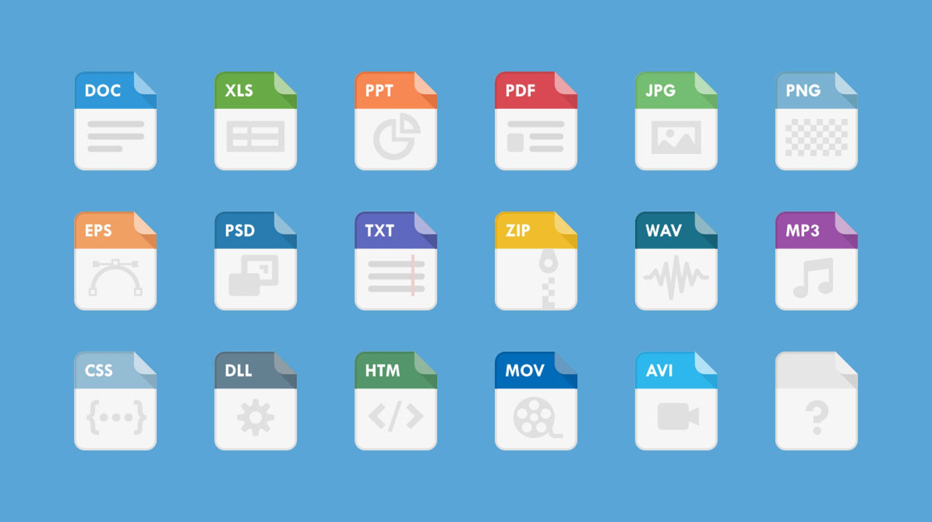
STEP 2
We Check file endings
And apply each a different filter
Else
Entropy

Slide 8
Detection algorithm
Consists of a few different methods.
Returns a percentage indicating the likelihood the file has been encrypted.
Compares the grade against our calculated threshold.
Returns a definite answer whether or not a file has been compromised.

Slide 9
Thank you!

